Slide 1
Cholesky decomposition – a tool with many uses
Tony O’Hagan, Leo Bastos
MUCM/SAMSI, April 07
Slide <number>

Slide 2
Prununciation
Cholesky was French …
  Sholesky
But his name is probably Polish …
  Kholesky
Or maybe Russian …
  Sholesky or
  Kholesky or
  Tsholesky
Take your pick!!
Slide <number>

Slide 3
Variance decompositions
Given a variance matrix Σ for a random vector X, there exist many matrices C such that
Σ = C C^{T}
  If C is such a matrix then so is CO for any orthogonal O
Then var(C⁻¹X) = I
  The elements of C⁻¹X are uncorrelated with unit variance
E.g.
  Eigenvalue decomposition C = QΛ^{½}
    Q orthogonal and Λ diagonal
    Familiar in principal component analysis
  Unique pds square root C = QΛ^{½}Q^{T}
    Σ = C²
Slide <number>

Slide 4
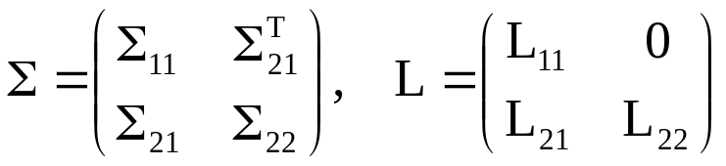
Cholesky decomposition
The Cholesky decomposition corresponds to the unique lower triangular matrix C
  Which I’ll write as L to emphasise it’s lower triangular
Partition Σ and L as
Then
  L₁₁L₁₁^{T} = Σ₁₁ , L₂₂L₂₂^{T} = Σ_{22.1} = Σ₂₂ – Σ₂₁Σ₁₁⁻¹Σ₂₁^{T}
  L⁻¹ is also lower triangular
Therefore
  The first p elements of L⁻¹X decompose the variance matrix of the first p elements of X
  Remaining elements decompose the residual variance of the remaining elements of X conditional on the first p
Slide <number>

Slide 5
Computing Cholesky
Recursion; take p = 1
  L₁₁ = √(Σ₁₁) (scalar)
  L₂₁ = Σ₂₁/L₂₁ (column vector divided by scalar)
  L₂₂ is the Cholesky decomposition of Σ_{22.1}
  Inverse matrix is usually computed in the same recursion
Much faster and more accurate than eigenvalue computation
  Method of choice for inverting pds matrices
Slide <number>

Slide 6
Principal Cholesky
There are many Cholesky decompositions
  Permute the variables in X
  Obviously gives different decomposition
Principal Cholesky decomposition (PCD)
  At each step in recursion, permute to bring the largest diagonal element of Σ (or Σ_{22.1}) to the first element
Analogous to principal components
  First Cholesky component is the element of X with largest variance
  Second is a linear combination of the first with the element with largest variance given the first
  And so on
Slide <number>

Slide 7
Numerical stability
Important when decomposing or inverting near-singular matrices
  A problem that arises routinely with Gaussian process methods
  I’ve been using PCD for this purpose for about 20 years
Division by √(Σ₁₁) is the major cause of instability
  Rounding error magnified
  Rounding error can even cause √(Σ₁₁) to be –ve
PCD postpones this problem to late stages of the recursion
  The whole of Σ_{22.1} is then small, and we can truncate
  Analogous to not using all the principal components
Slide <number>

Slide 8
Fitting emulators
A key step in the fitting process is inverting the matrix A of covariances between the design points
  Typically needs to be done many times
Problems arise when points are close together relative to correlation length parameters
  A becomes ill-conditioned
    E.g. points on trajectory of a dynamic model
    Or in Herbie’s optimisation
  PCD allows us to identify redundant design points
  Simply discard them
But it’s important to check fit
  Observed function values at discarded points should be consistent with the (narrow) prediction bounds given included points
Slide <number>

Slide 9
Validating emulators
Having fitted the emulator, we test its predictions against new model runs
We can look at standardised residuals for individual predicted points
  But these are correlated
Mahalanobis distance to test the whole set
D = (y – m)^{T}V⁻¹(y – m)
  Where y is new data, m is mean vector and V is predictive variance matrix
  Approx χ² with df equal to number of new points
Any decomposition of V decomposes D
  Eigenvalues useful but may be hard to interpret
Slide <number>

Slide 10
Validating emulators (2)
PCD keeps the focus on individual points, but conditions them on other points
  Initially picks up essentially independent points
  Interest in later points, where variance is reduced conditional on other points
  In principle, points with the smallest conditional variances may provide most stringent tests
    But may be badly affected by rounding error
Slide <number>

Slide 11
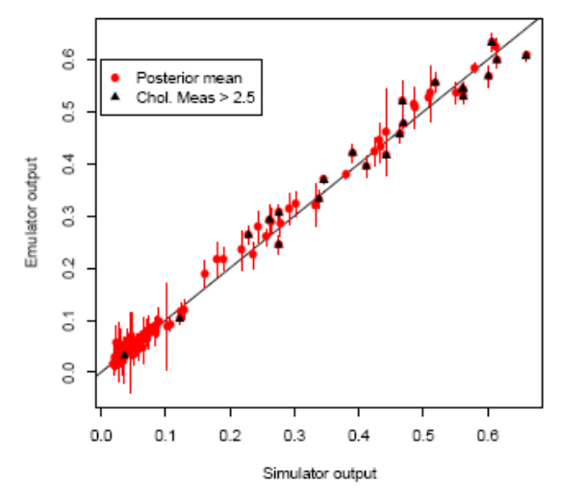
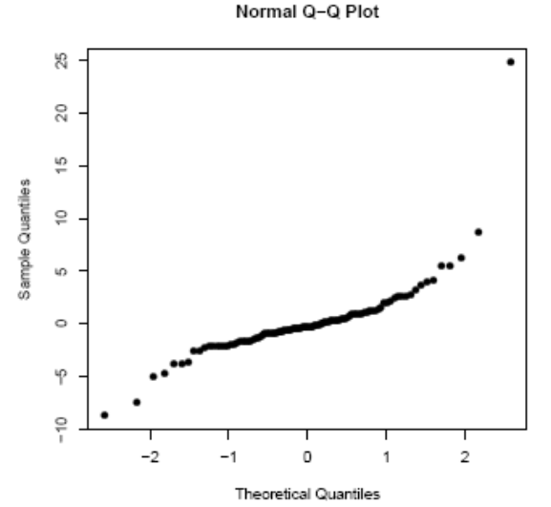
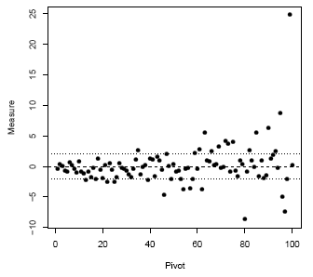
Example
Nilson-Kuusk Model
Analysis by Leo Bastos
5 inputs, 150 training runs
100 validation runs
D = 1217.9
Slide <number>

Slide 12
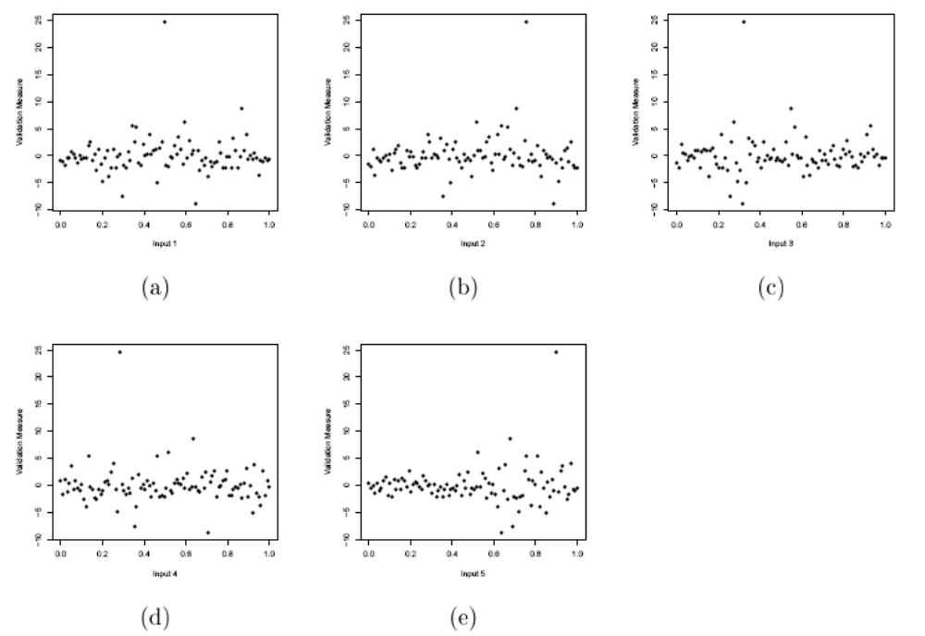
Example (cont)
Plots of PCD components against each of the 5 inputs
Slide <number>

Slide 13
Functional outputs
Various people have used principal components to do dimension reduction on functional or highly multivariate outputs
PCD selects instead a subset of points on the function (or individual outputs)
  Could save time if not all outputs are needed
  Or save observations when calibrating
  Helps with interpretation
  Facilitates eliciting prior knowledge
Slide <number>

Slide 14
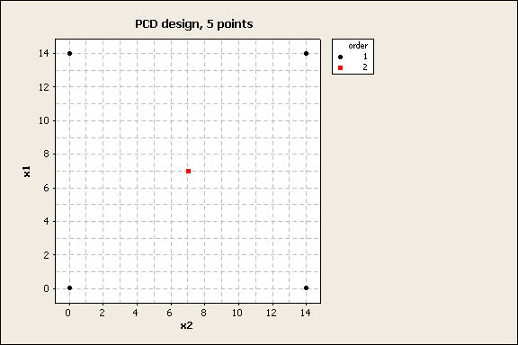
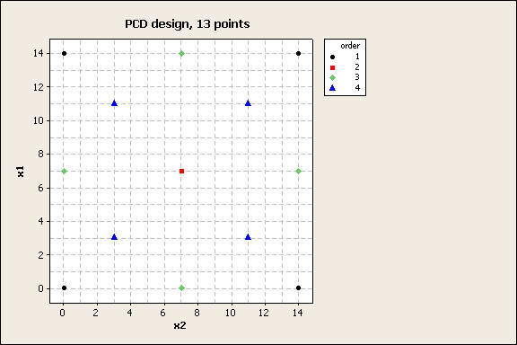
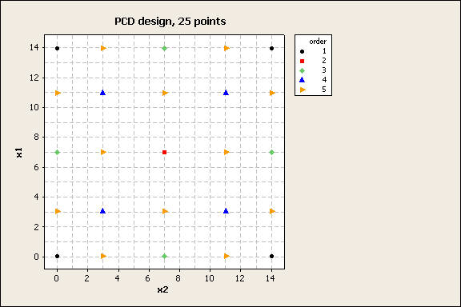
Design
Given a set of candidate design points, PCD picks ones with highest variances
  Strategy already widely advocated
Four corners first.
Then centre.
Next come centres of the sides.
Then the four blue points
The next 12 points fill in a 5x5 grid.
Slide <number>

Slide 15
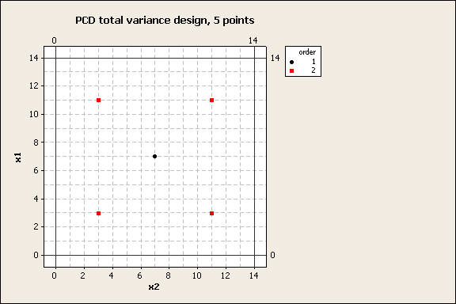
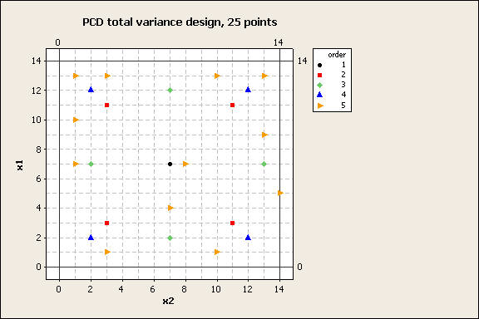
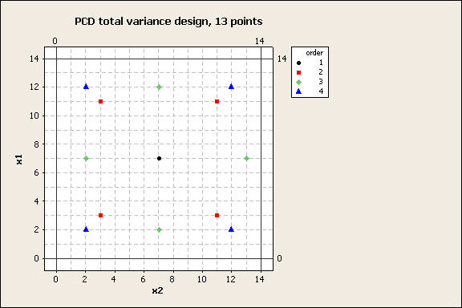
Design (2)
However, an alternative is to pick points that most reduce uncertainty in remaining points
At each step of the recursion, choose point that maximises L₁₁ + L₂₁L₂₁^{T}/L₁₁
First point in the centre.
Then 4 points around it.
Next we get the 4 green points (notice first loss of symmetry).
The four blue points are a surprise!
The next 12 are all over the place, but still largely avoid the central area.
Slide <number>

Slide 16
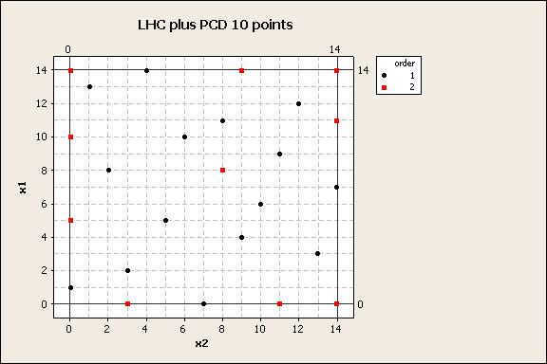
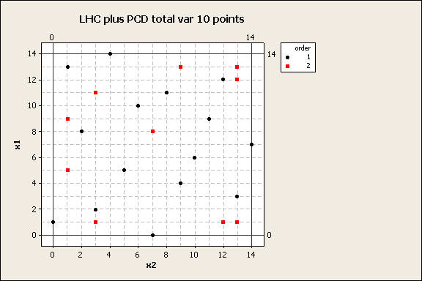
Design (3)
Consider adding points to an existing latin hypercube design
Total variance version again fills space less evenly, but …?
Slide <number>

Slide 17
Conclusion(s)
I ♥ Cholesky!
Slide <number>

